Slide 1

SVKM’s Institute of Technology , Dhule Department of Information Technology
Project Presentation
On
“Cyclone Intensity Estimation using Deep Learning”
By
17 – Abhinash Kailash Joshi
22 – Rohan Vijay Mahajan
24 – Aditya Jitendra Mali
34 –Kalpesh Narendra Patil
Guide
“ Prof. Mangesh Balpande”
Day and Date of Review : Wednesday, 9 August 2023

Slide 2
Contents
Project Group
Project Motivation
Introduction
System Architecture
Design Diagrams

Slide 3
Project Details
Project Title : “Cyclone Intensity Estimation using Deep Learning”
Project Domain: Artificial Intelligence
Project Group Members:
T2054491246002 , Abhinash Kailash Joshi
T2054491246046 , Rohan Vijay Mahajan
T2054491246003 , Aditya Jitendra Mali
T2054491246024 , Kalpesh Ravindra Patil

Slide 4
Motivation
Public safety and Preparedness
Disaster Response Planning
Infrastructure Protection
Agriculture and Economy
Environmental impact

Slide 5
Problem statement
Development of a deep Convolutional Neural Network (CNN) for Tropical Cyclone intensity estimation using half-hourly INSAT-3D IR Images and development of a web application for visualization of the imagery.

Slide 6
Abstract
We propose a deep Convolutional Neural Network (CNN) to estimate tropical cyclone intensity using half-hourly infrared (IR) images from the INSAT-3D satellite. Traditional methods rely on accurate center determination, often challenging during early cyclone stages. Our CNN model will trained on a dataset, directly estimates intensity from IR images, bypassing center accuracy. We will develop a user-friendly web application for visualizing the imagery, enhancing accessibility for meteorologists, researchers, and the public, aiding disaster preparedness.

Slide 7
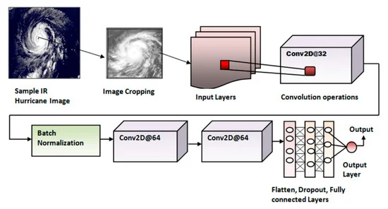
Proposed Methodology

Slide 8
Question & Answer
Thank You

